Slide 1


Slide 2
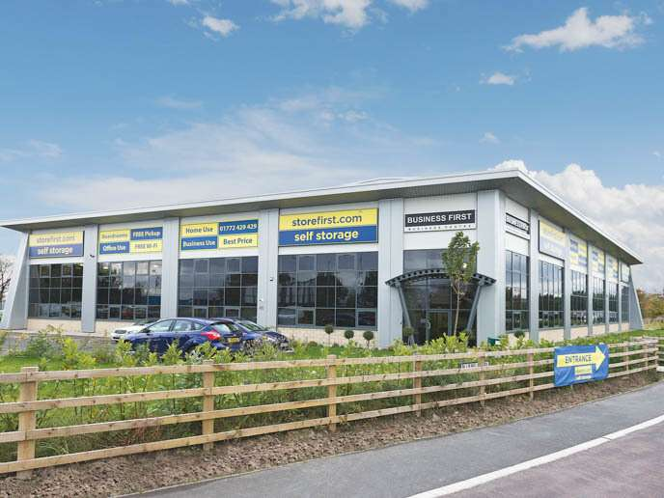
Our location…
Business First Centre Millennium Road, Millennium Park.
Preston.
PR2 5BL

Slide 3
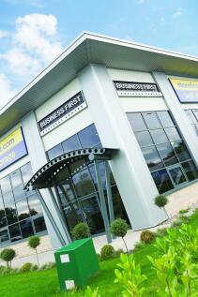
The front entrance…..

Slide 4
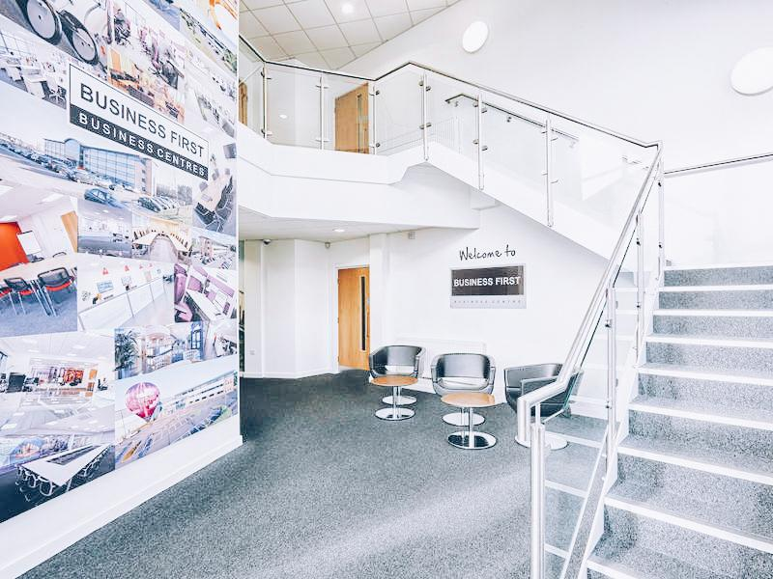
The Reception Area
You will be greeted by your teacher and escorted to our Learning Hub

Slide 5
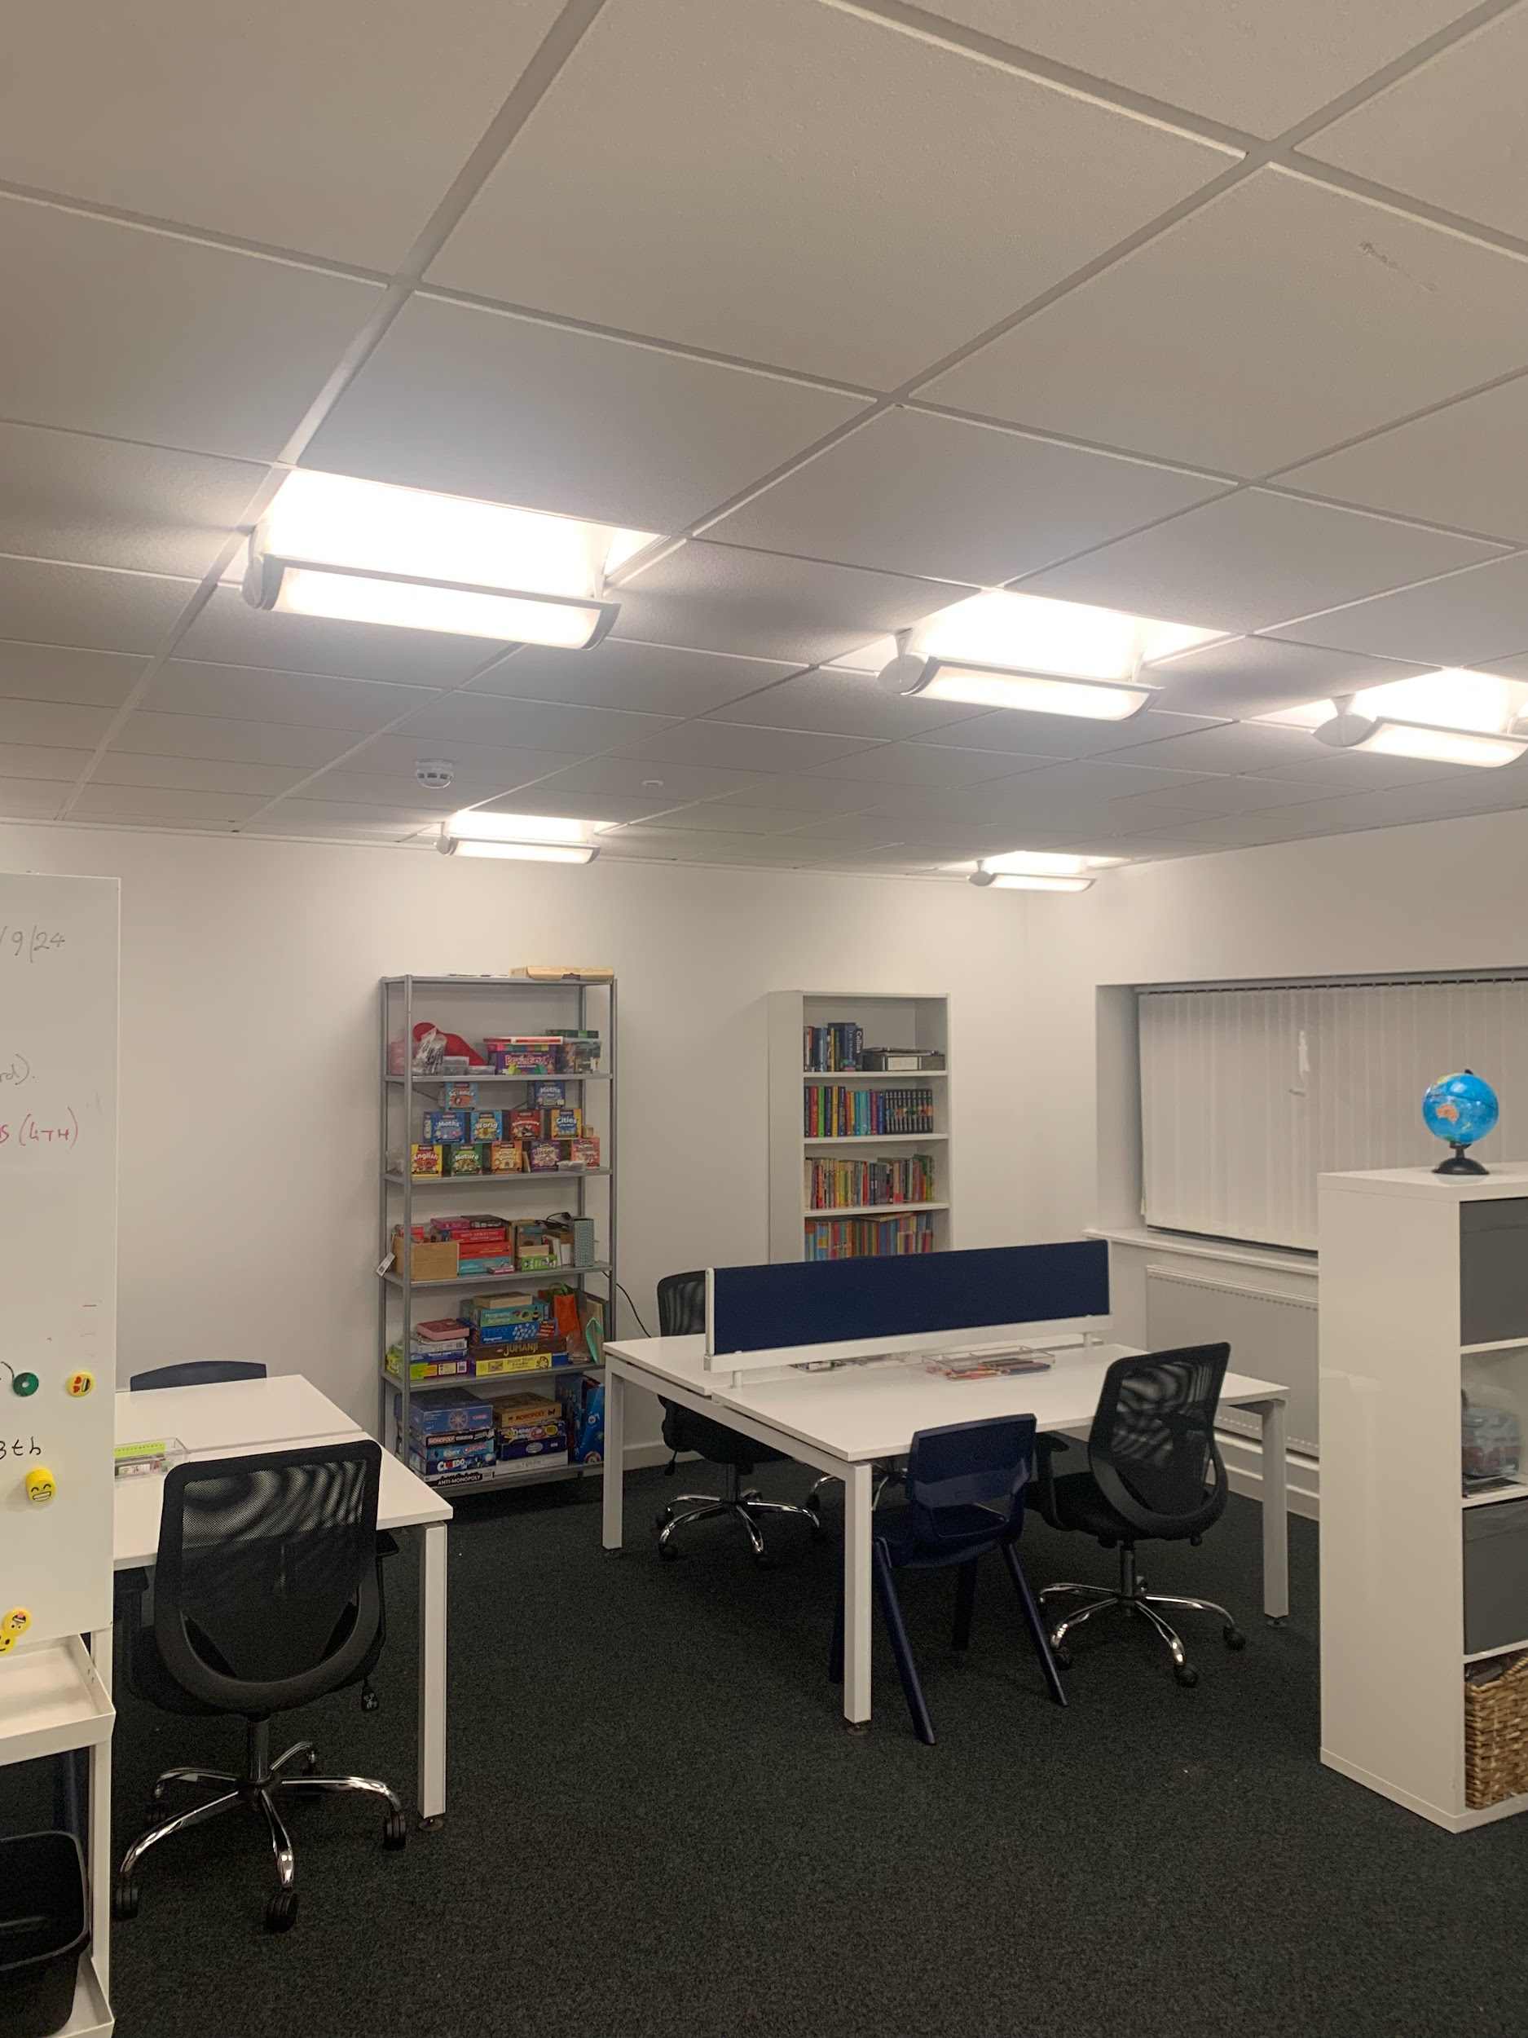
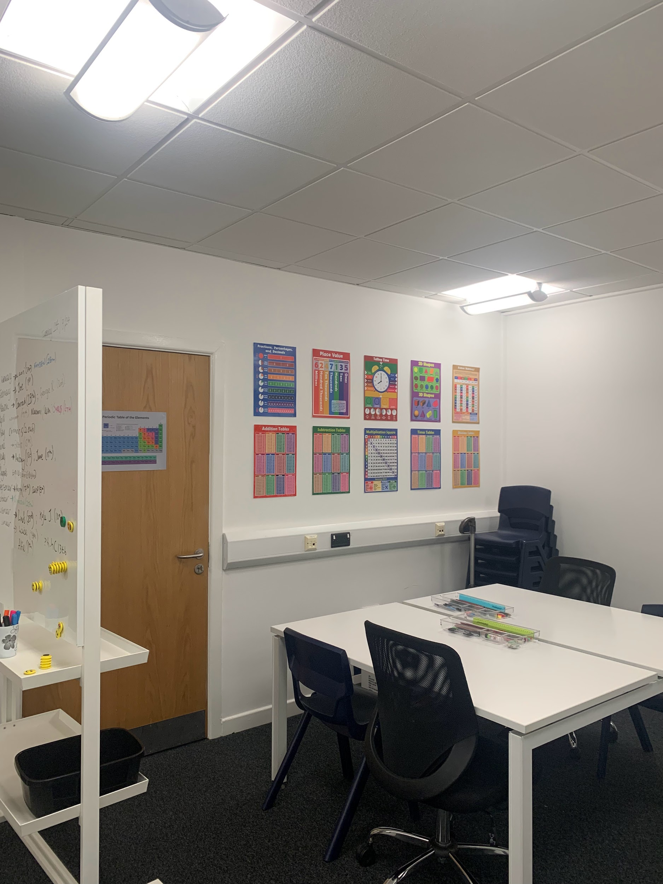
The Learning Hub
We provide everything. Just bring yourself!

Slide 6
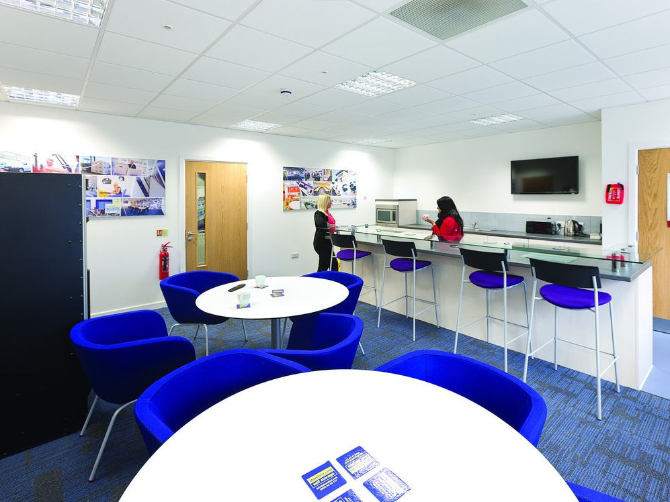
The Communal/ Kitchen Lounge
We provide all refreshments including tea, coffee and juice. And toast to those who missed breakfast!

Slide 7
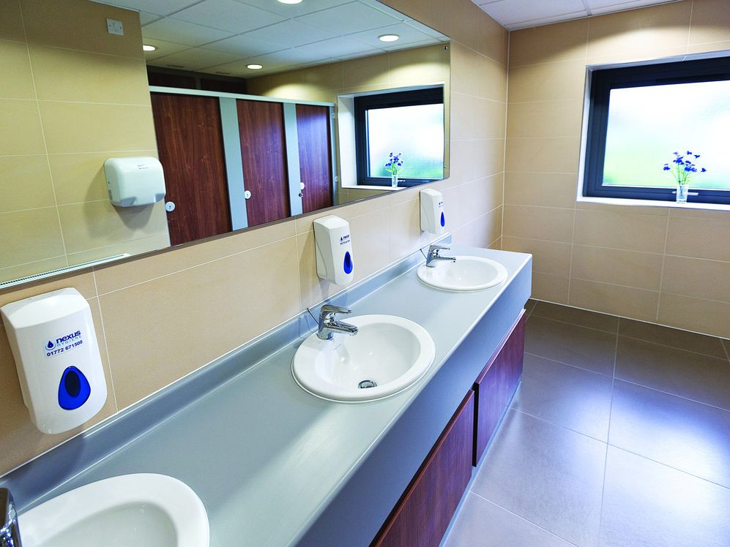
Toilets
Male, female and disabled toilets are available.

Slide 8
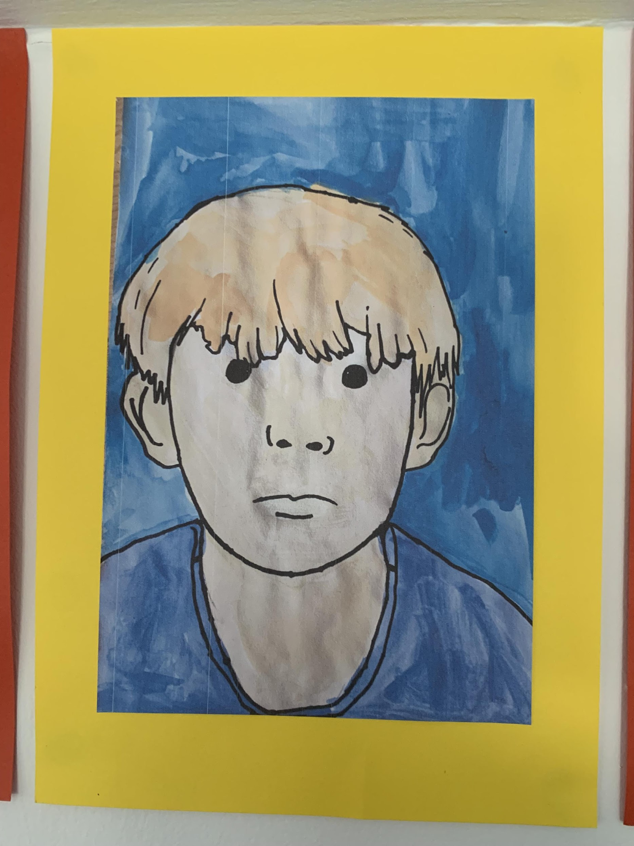
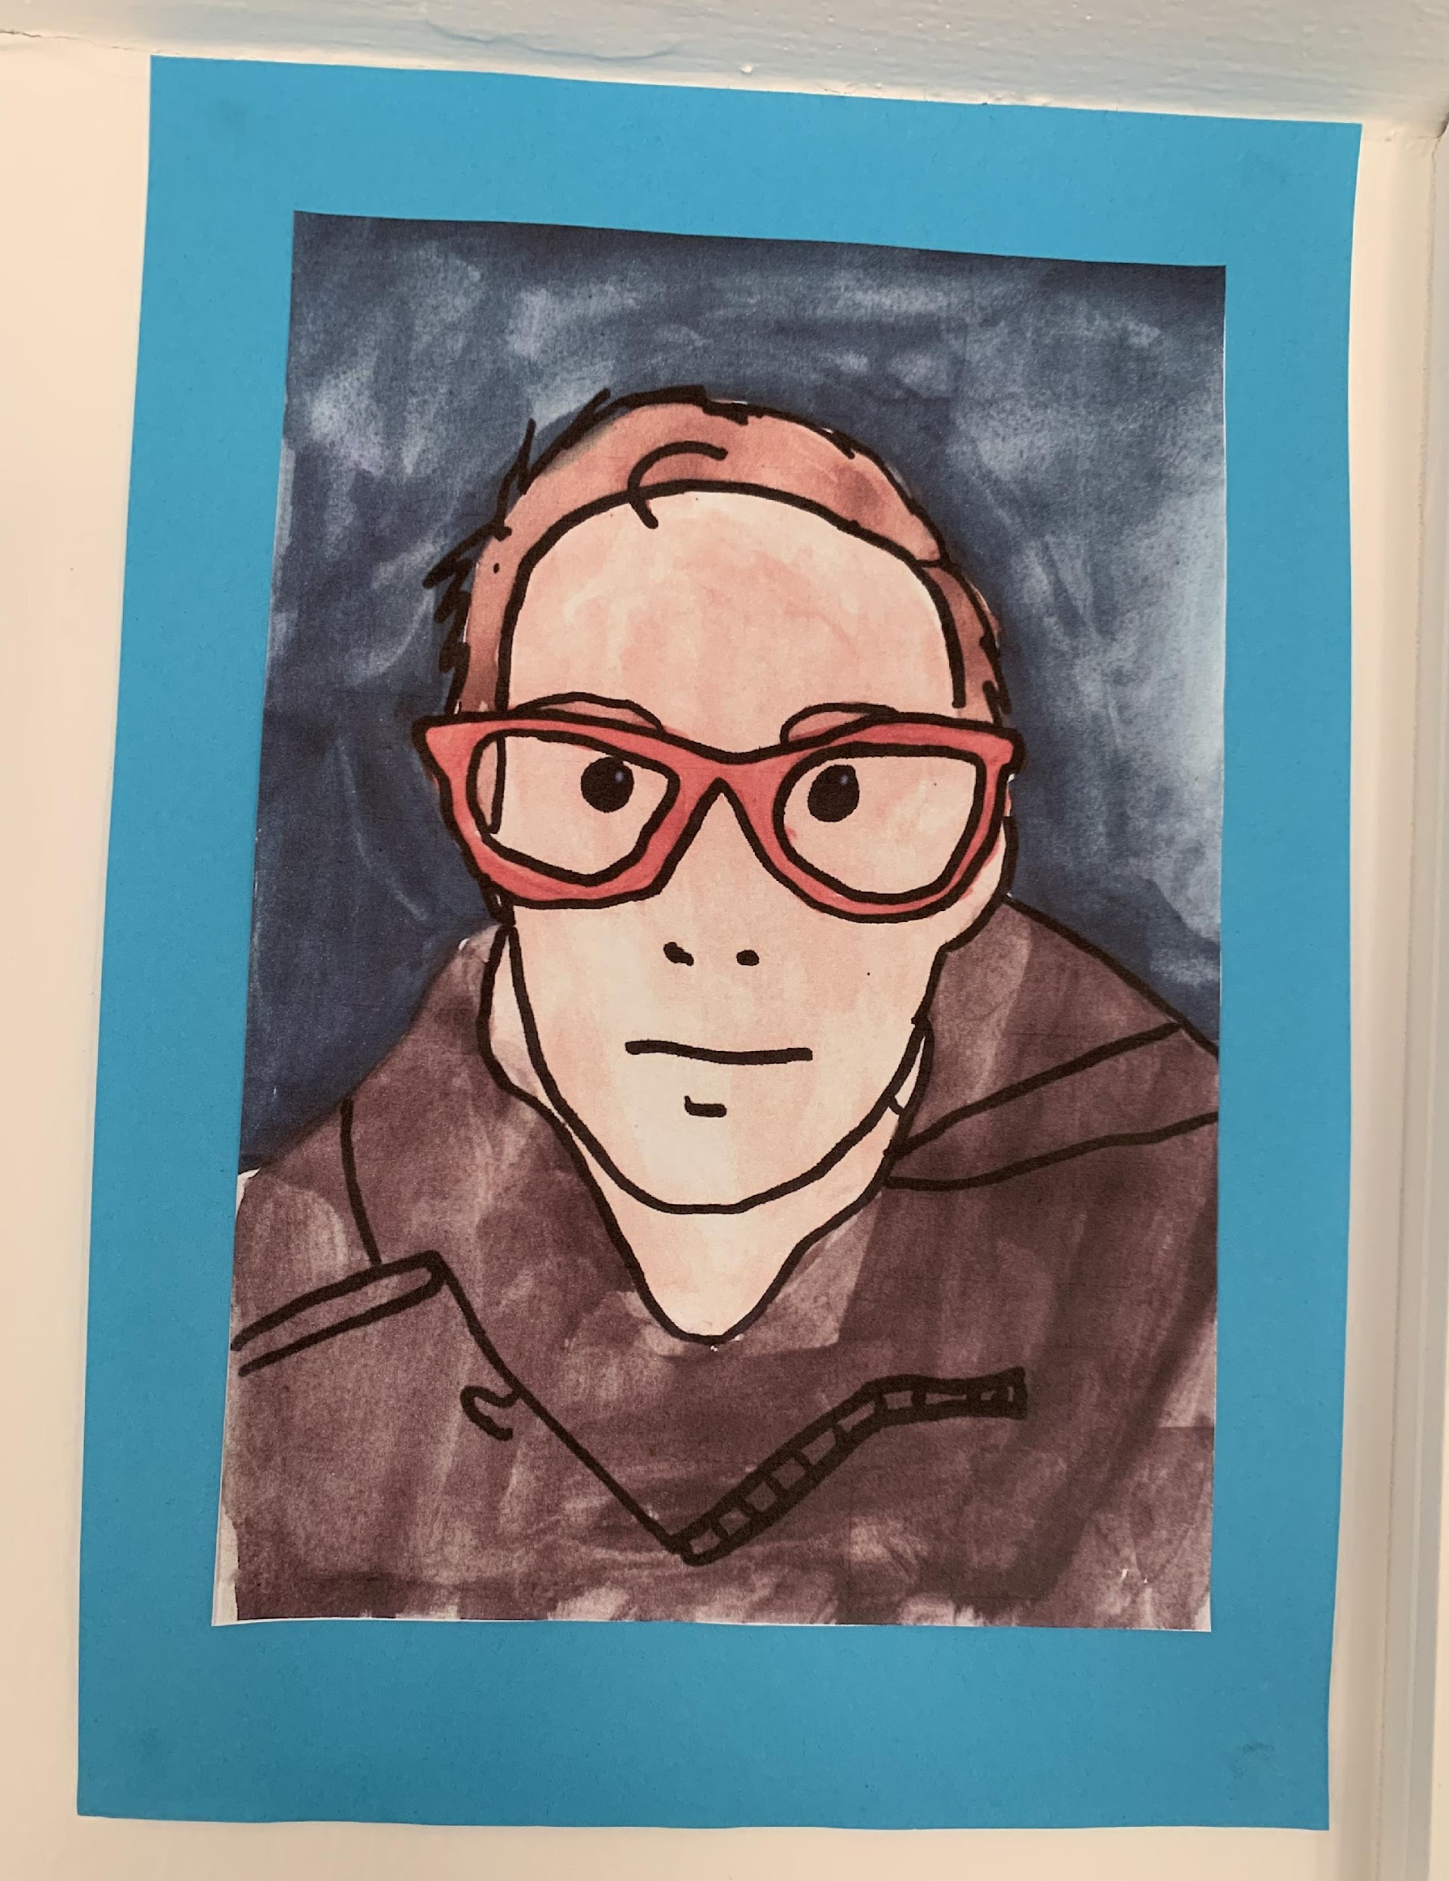
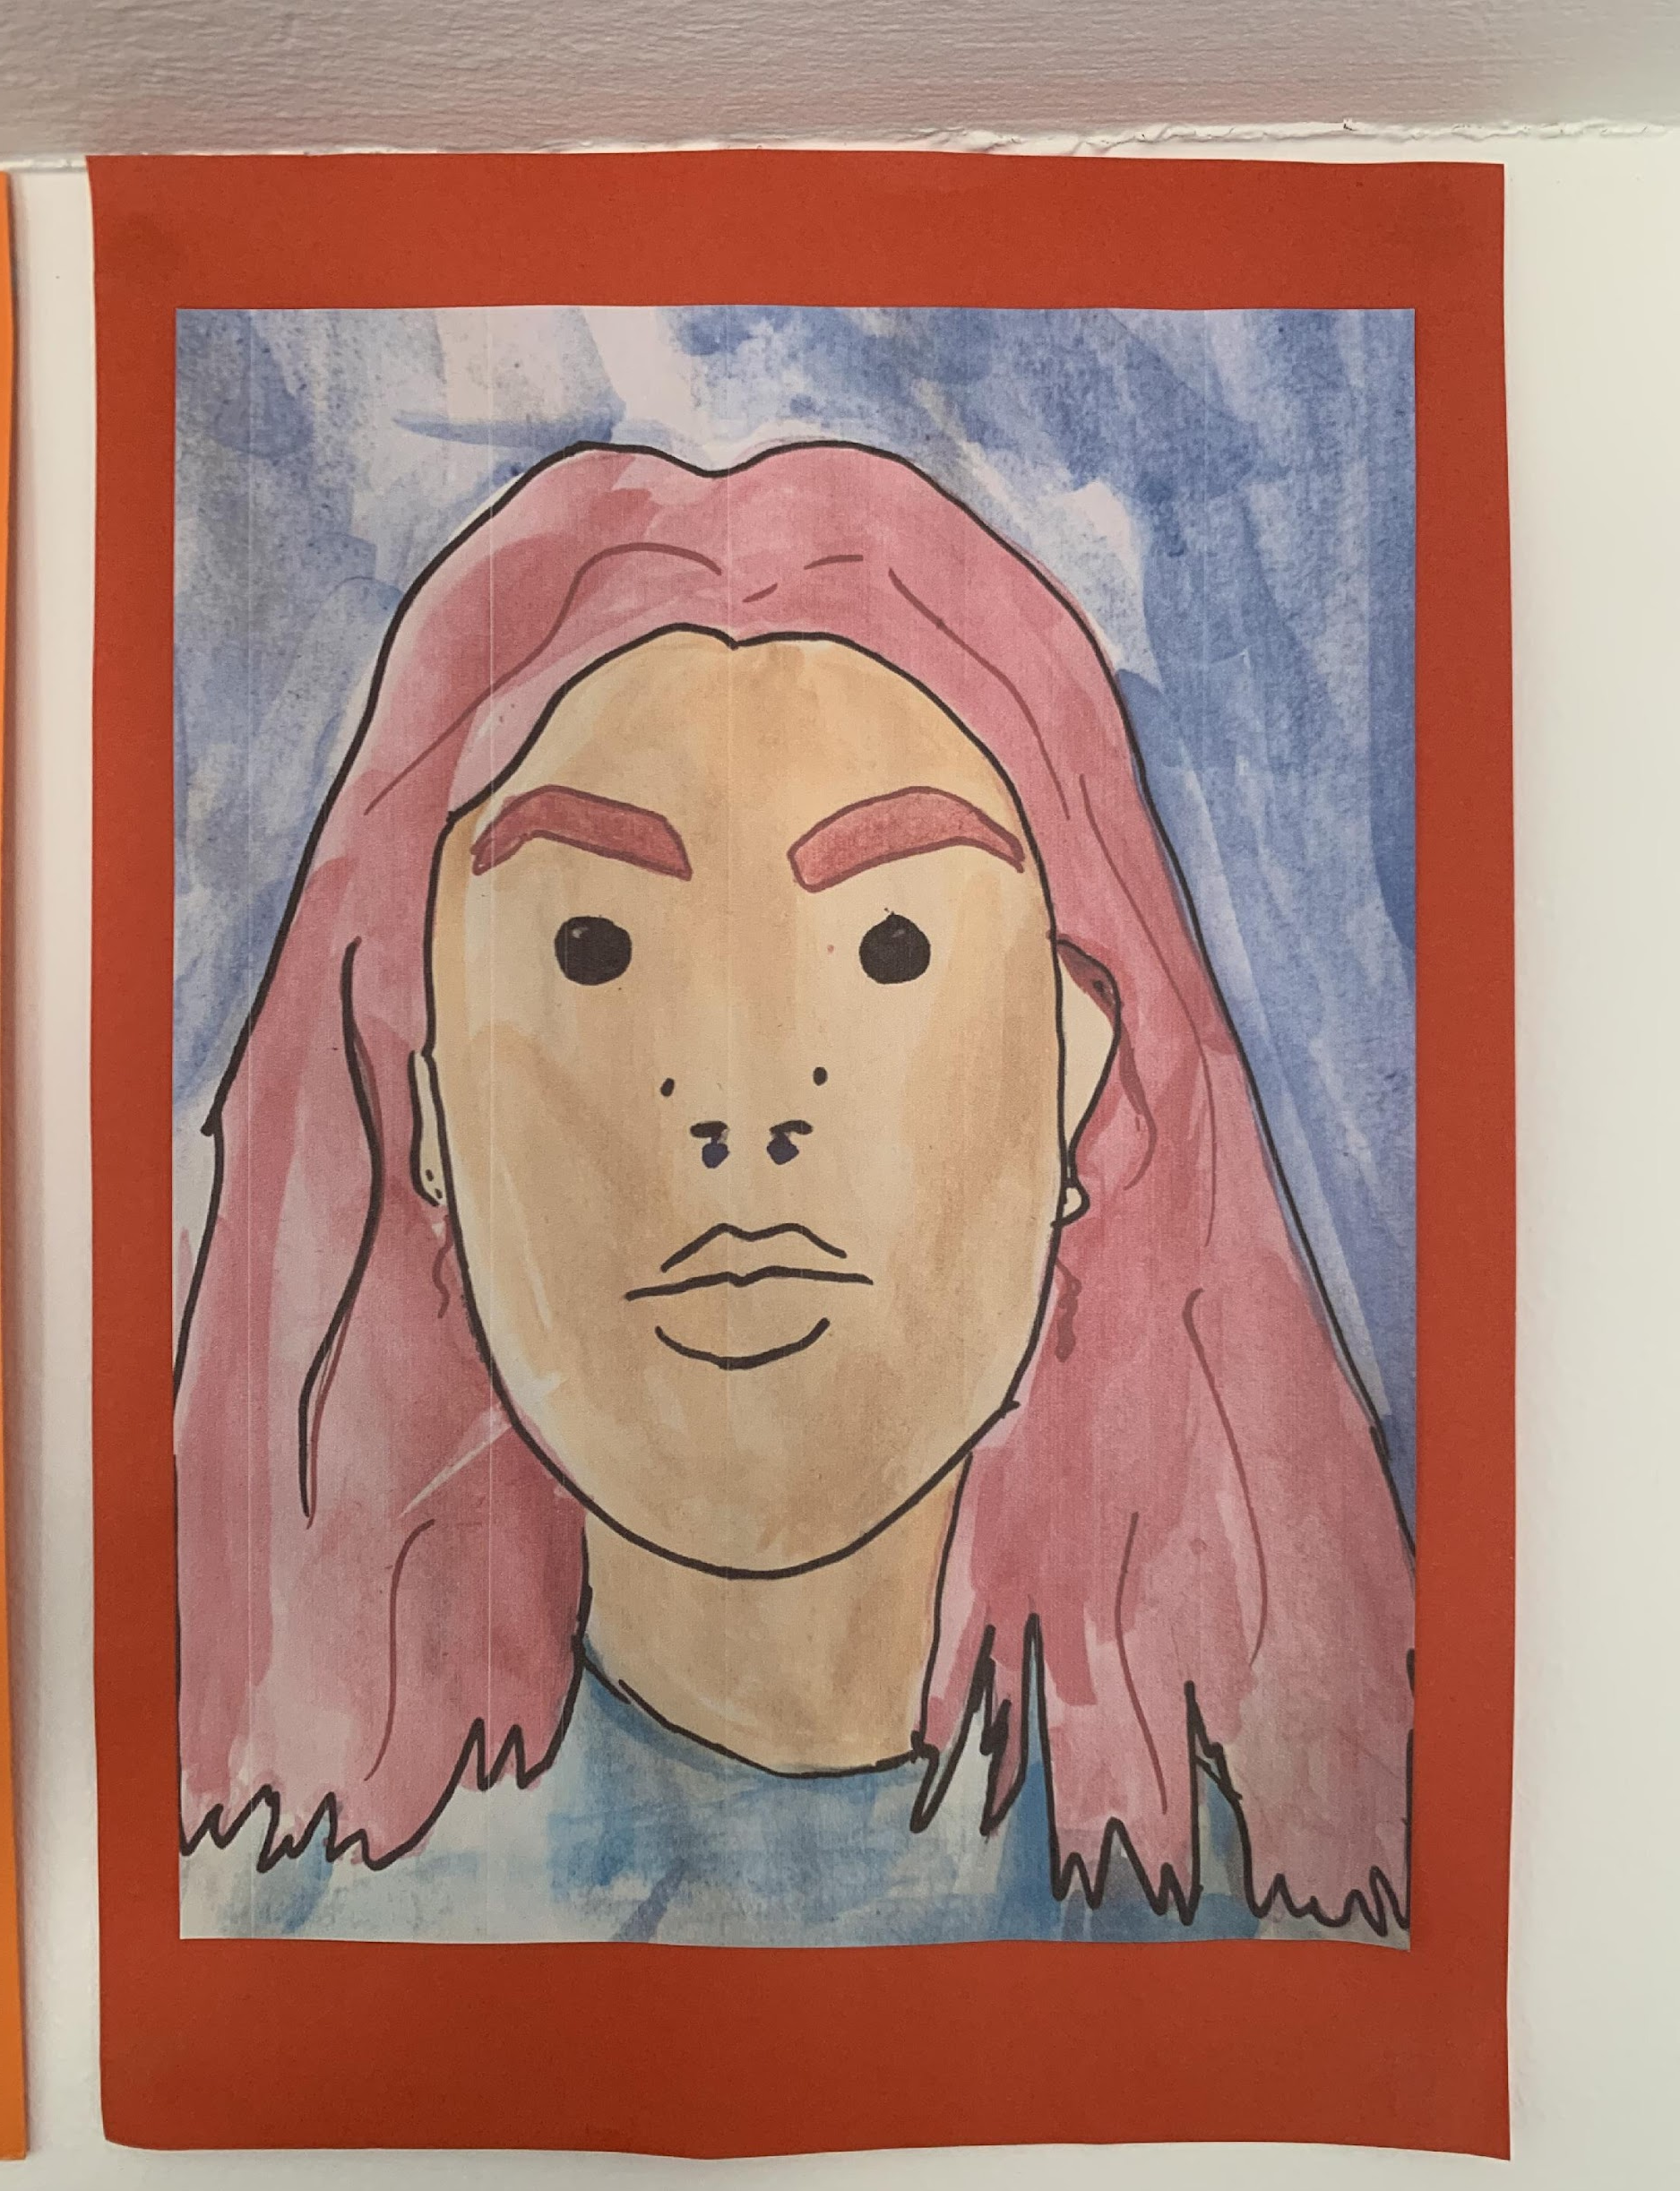
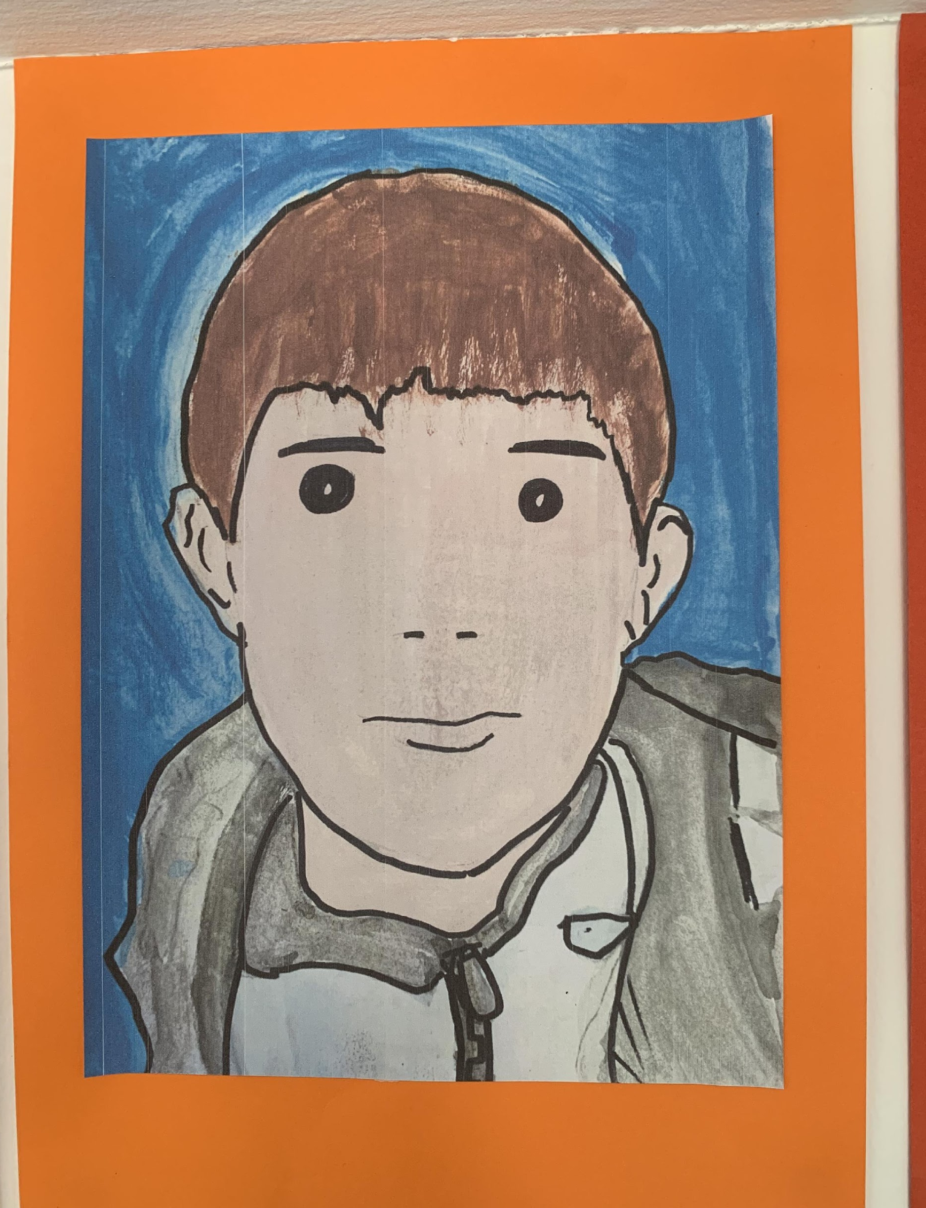
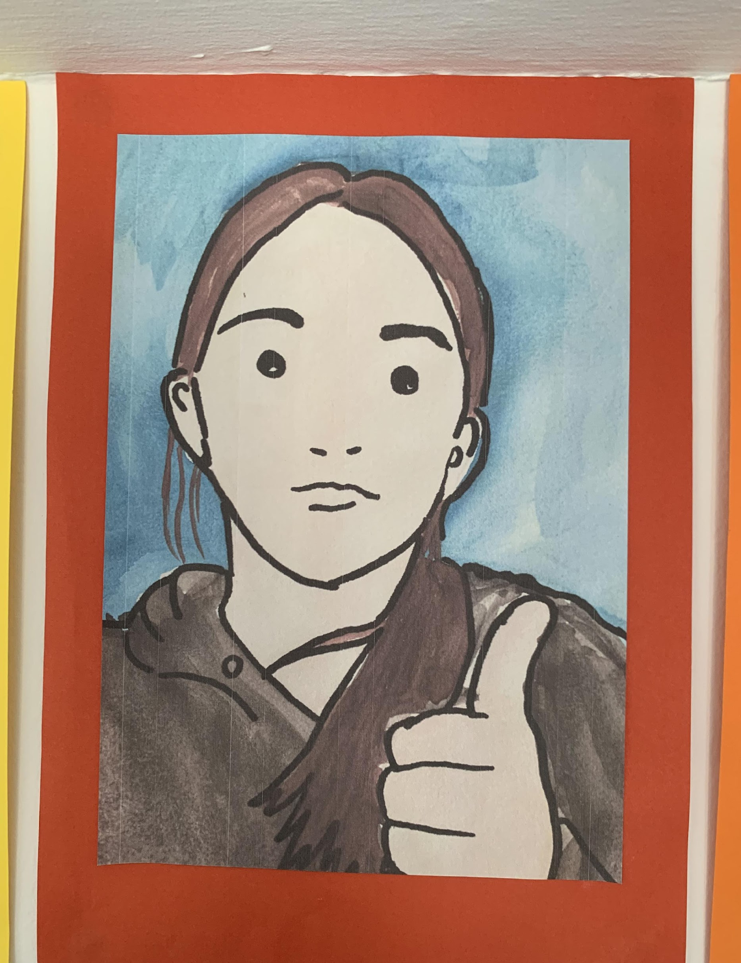
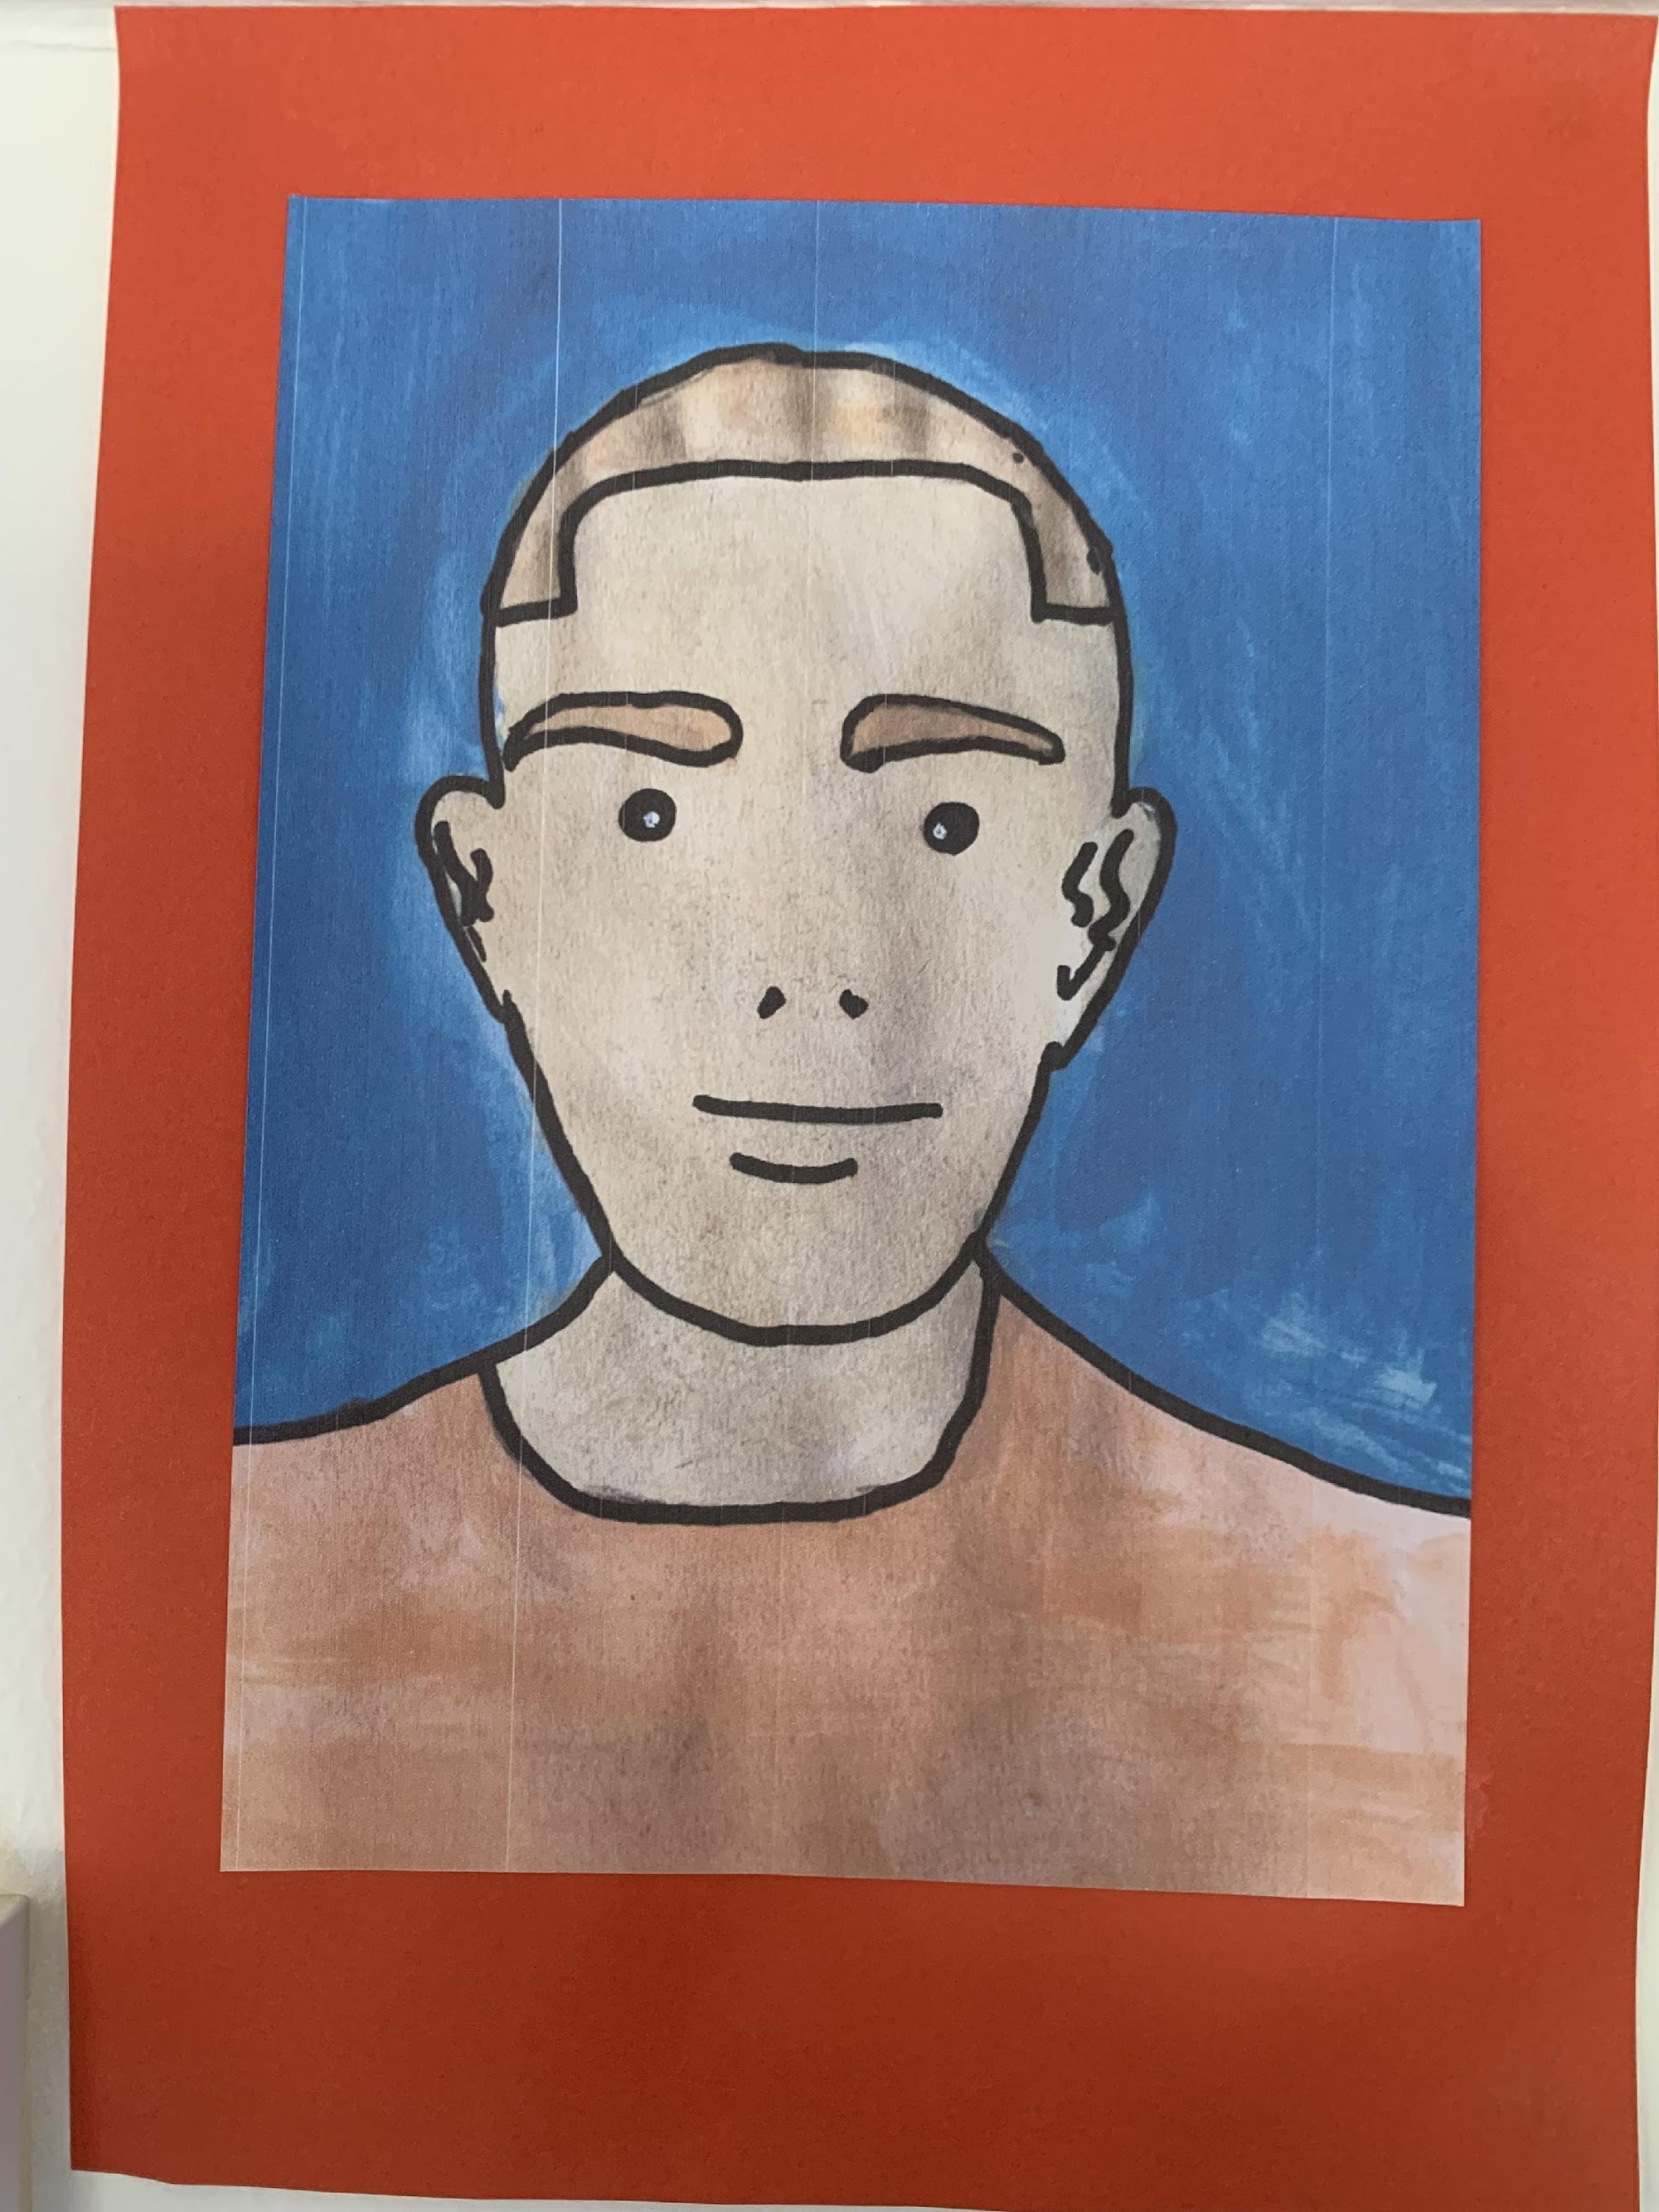
Meet some of our other students…

Slide 9
We look forward to supporting you on your educational journey.

